Slide 1
Collaborative Research and Development ‘Seed’ Project 2002-03
The learning and teaching of language arts at secondary level
Short Story: The Fence
School: Lee Kau Yan Memorial School
Teacher: Mr Man Ka Yiu, John
Level: Secondary 1
Date: 9 May 2003

Slide 2
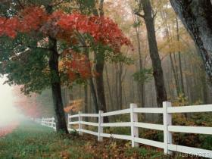
Fence

Slide 3
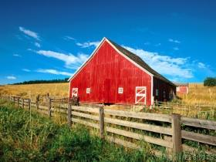
Fence

Slide 4
Worksheet 1
Read the first part of the story now.

Slide 5
Father
Little boy

Slide 6
Every time you lose your temper, you must hammer a nail into the back of the fence.
A bag of nails

Slide 7
37 nails

Slide 8
It’s easier to hold my temper than to drive these nails into the fence.

Slide 10
??????????????????????
What did the father suggest the boy?

Slide 11
Draw a comic strip to tell us your story.

Slide 12
Sharing Time

Slide 13
Worksheet 2
Read the whole story and compare your story with the original one.

Slide 14
Worksheet 3
Group Discussion
Have you ever lost your temper? When? What happened?
Please suggest one way to control your temper.

Slide 15
Example
Student 1
Name_________________________
Why did you lose your temper?
Please suggest one way to control your temper.
Johnathan
My friends called me ‘fat pig’ when I was in Primary 2. I hit their head and the teacher punished me.
When I lose my temper, I will do some sports like running and swimming.

Slide 16
Sharing Time

Slide 17
Questions
Do you want to hold your temper? Why?
How should you treat your friend? Why?

Slide 18
Worksheet 4
‘Friendship Week’
Poster Design Competition
What is a Friend?

